Slide 1
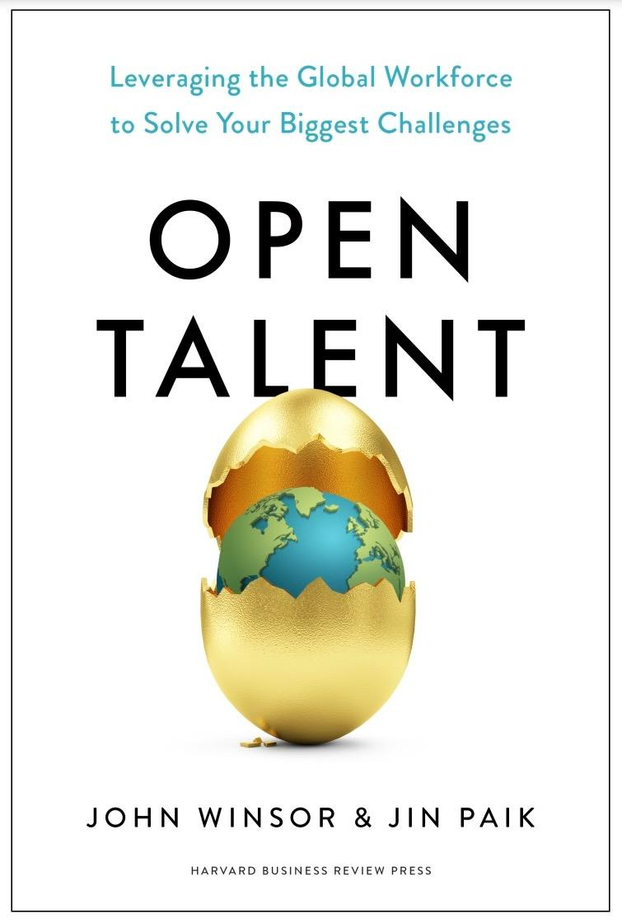
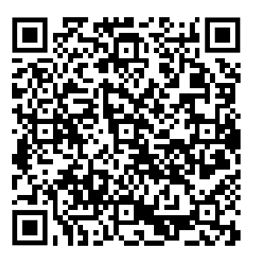

Slide 3
Outside-in perspective

Slide 4
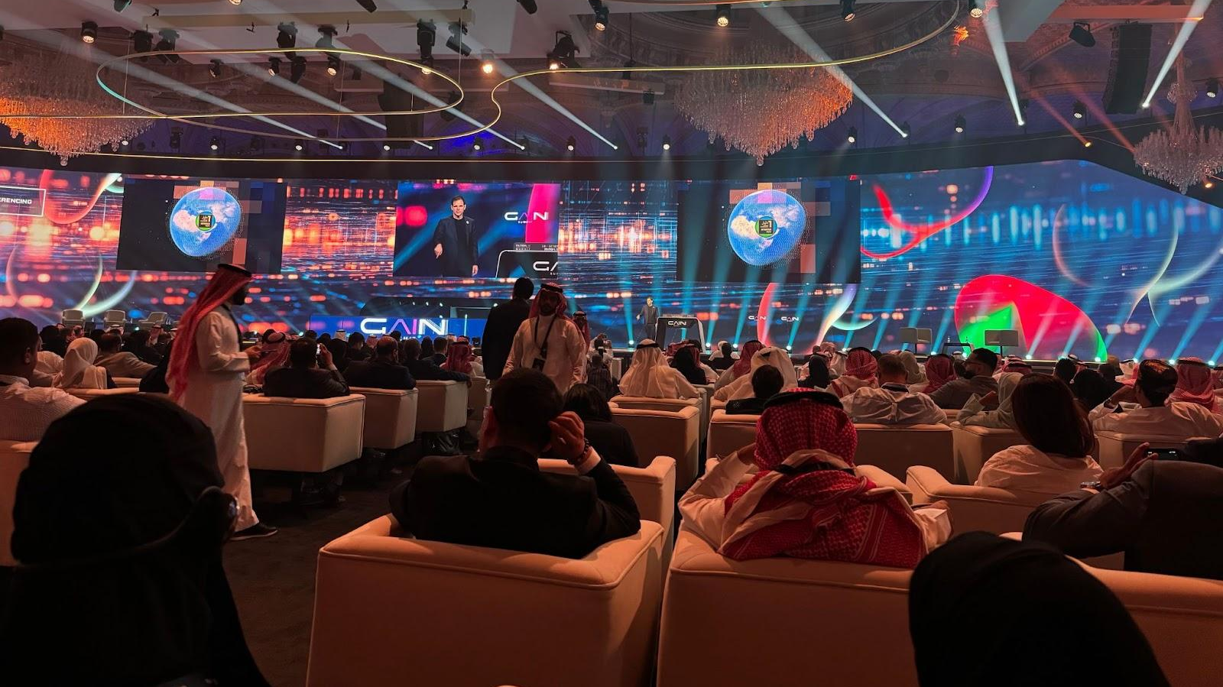

Slide 5
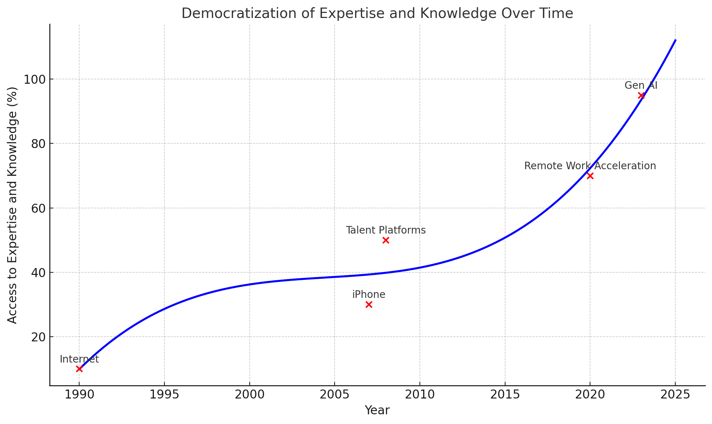

Slide 6
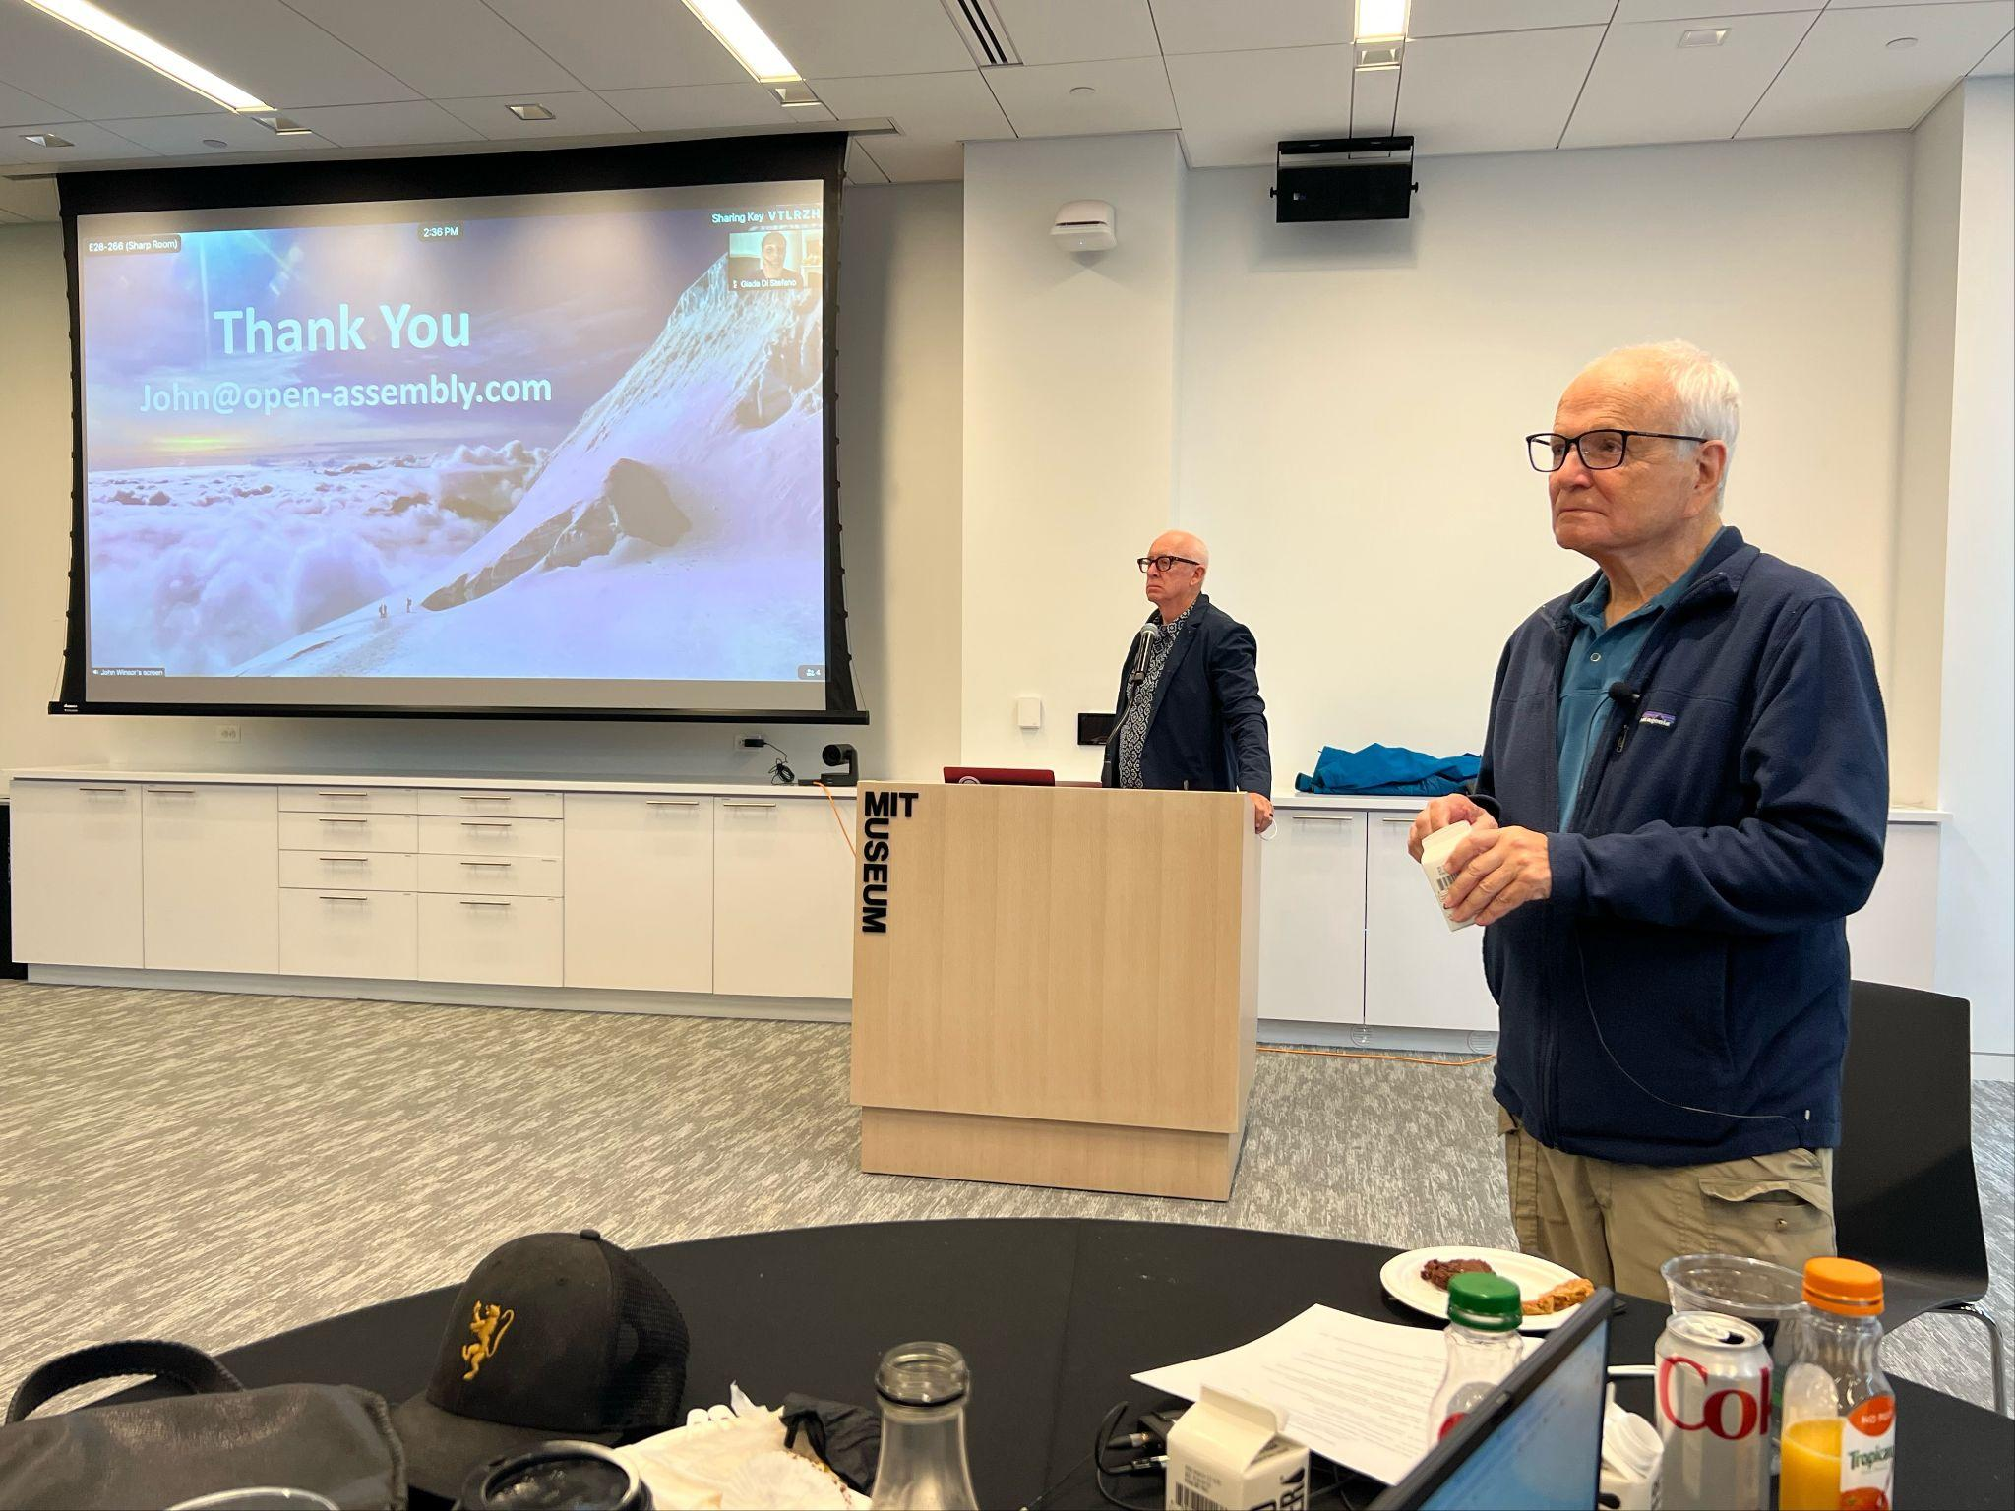

Slide 7
“Organizations built on static, immovable, uneditable systems will find themselves in the dustbin of history.”
- Eric Von Hippel

Slide 8
Yet, incumbent organizations never see it coming.

Slide 9
1897

Slide 10
“Radio has no future.”
- Lord Kelvin, British mathematician and physicist

Slide 11
1903

Slide 12
“The horse is here to stay, the automobile is only a fad.”
- Horace Rackham, lawyer for Henry Ford

Slide 13
1977

Slide 14
“There is no reason for any individual to have a computer in their home.” - Kenneth Olsen, president and founder of Digital Equipment Corp.

Slide 15
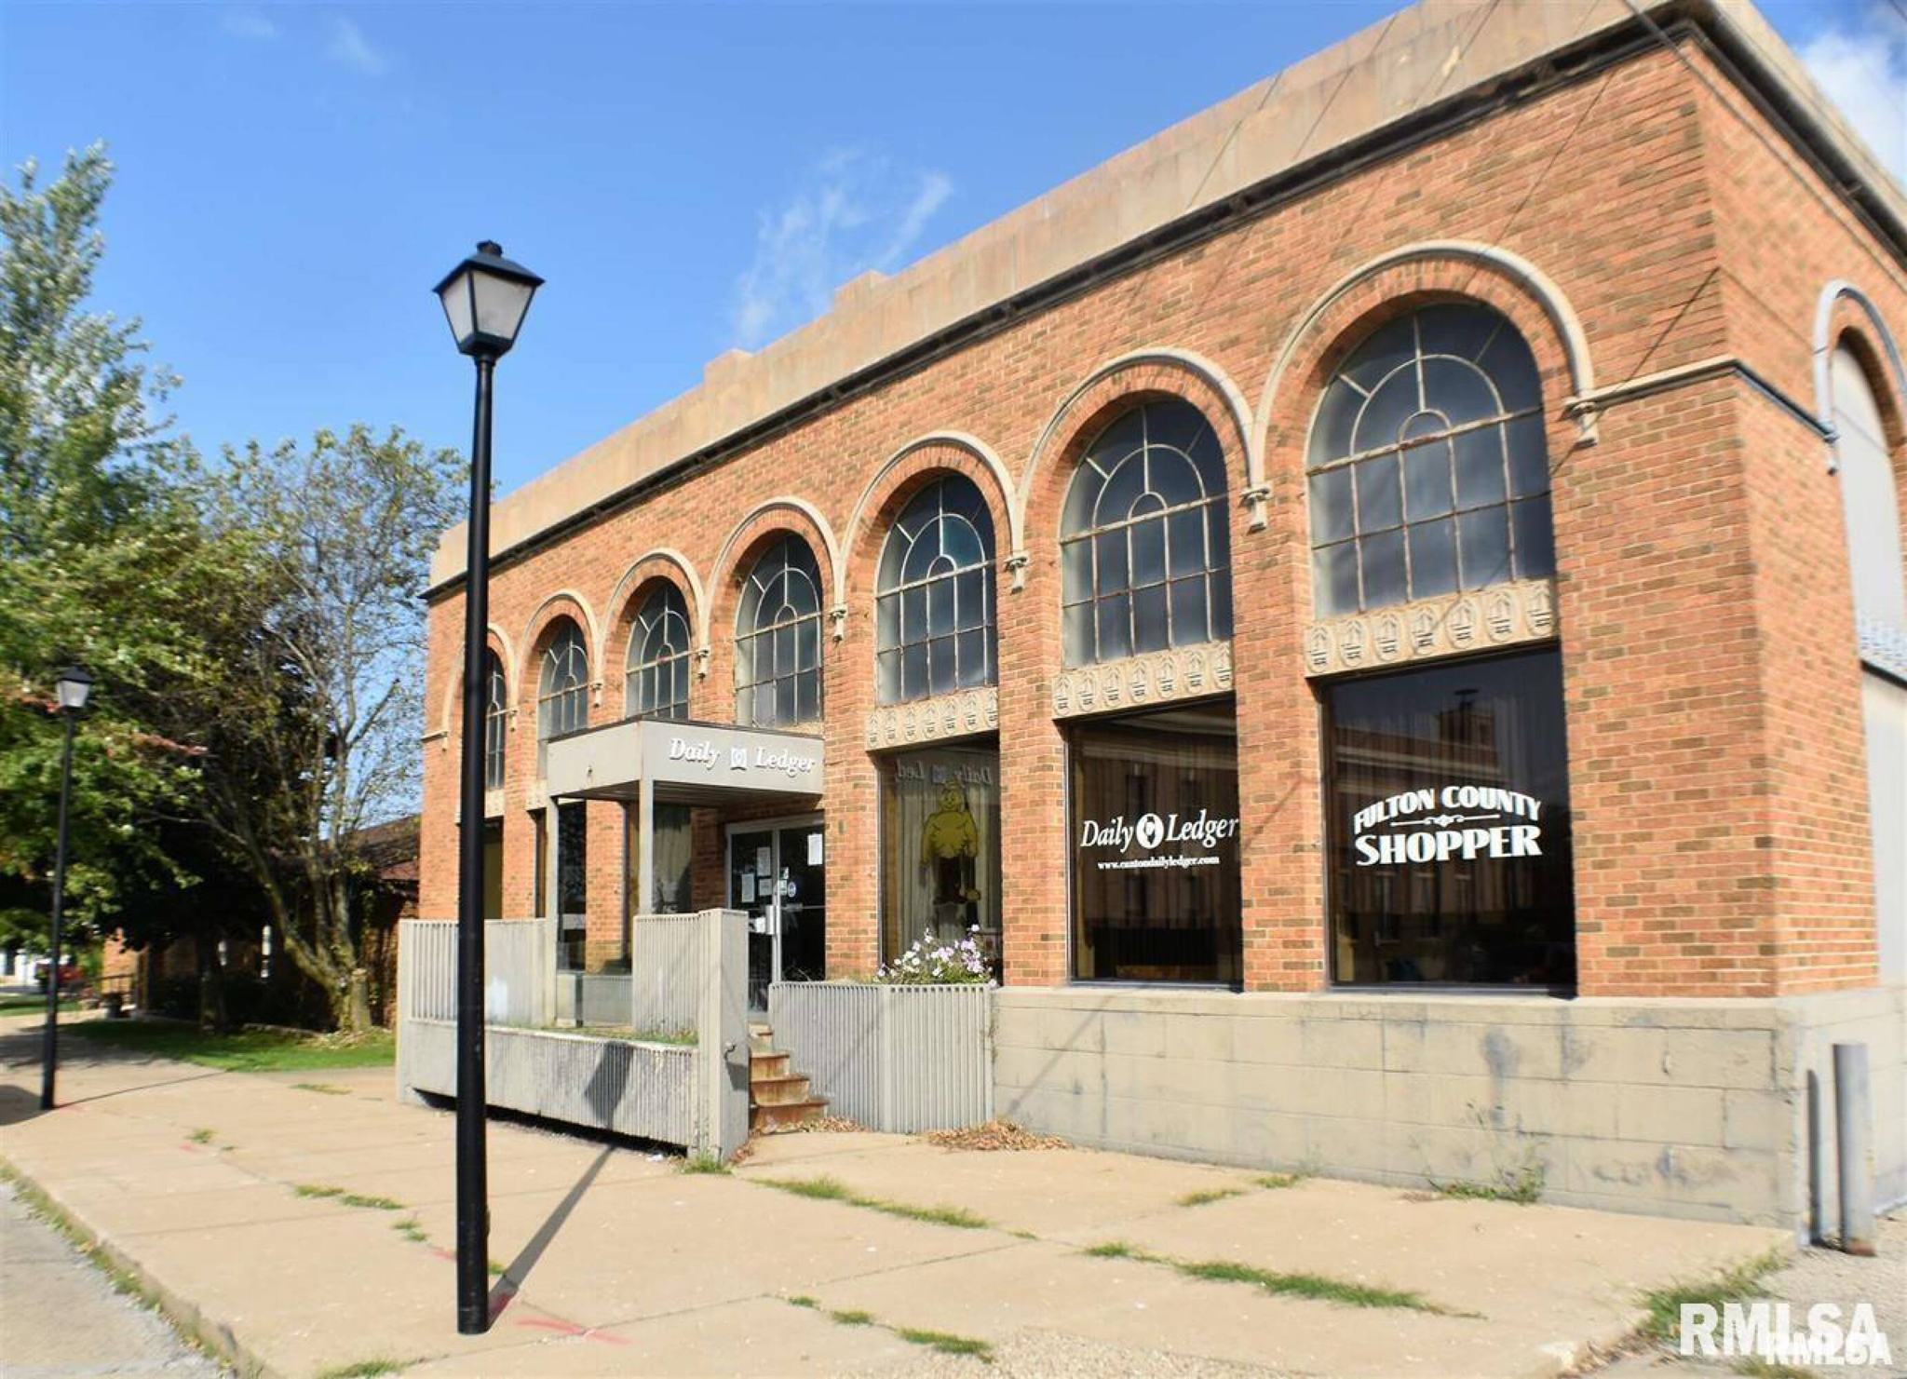

Slide 16
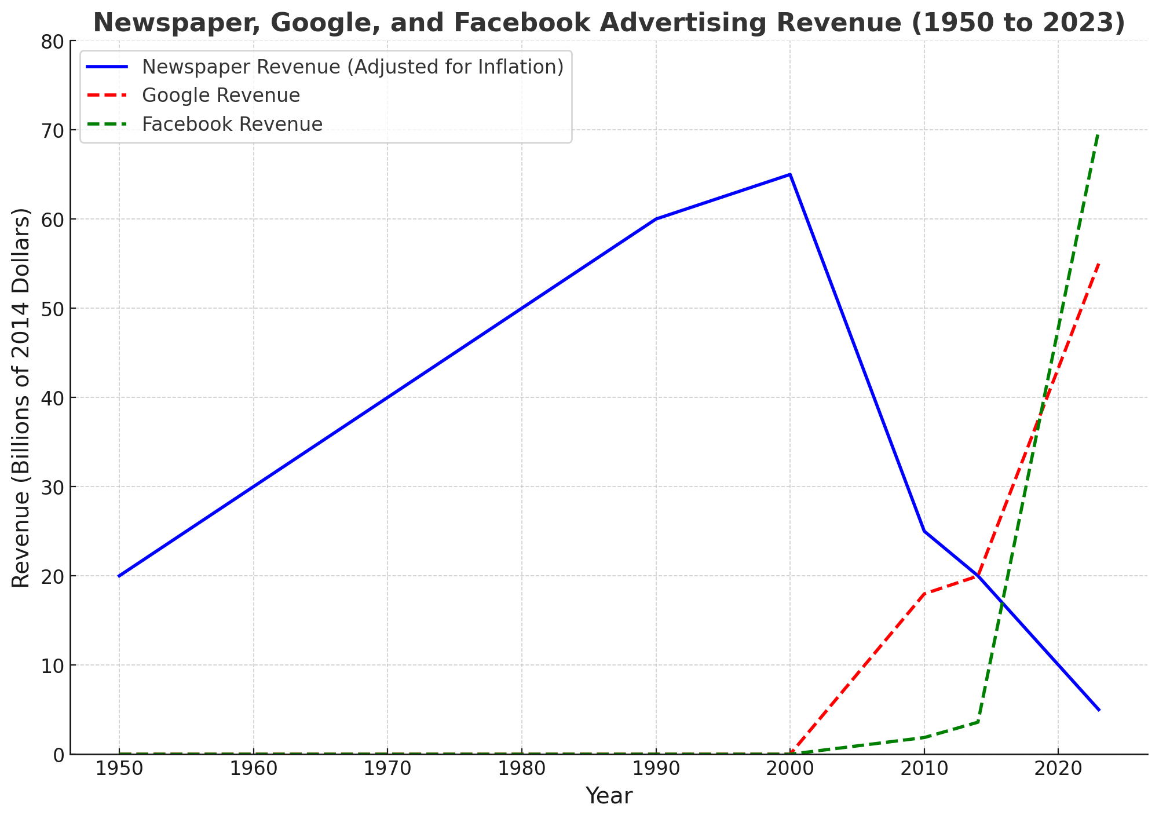

Slide 18
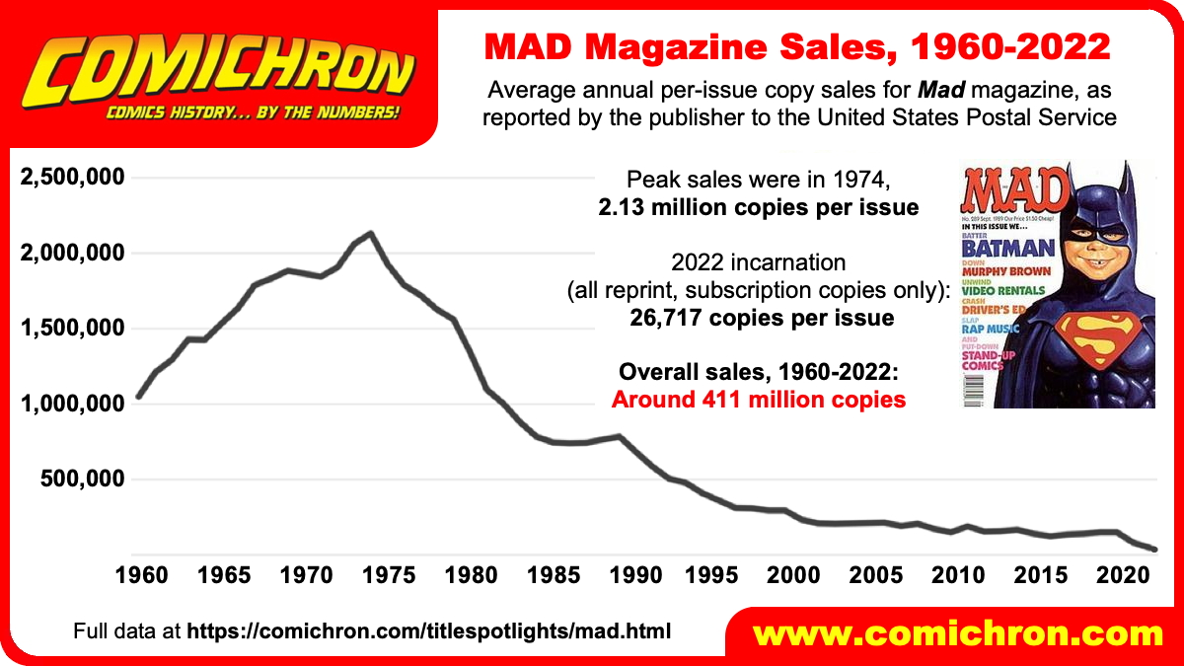

Slide 19
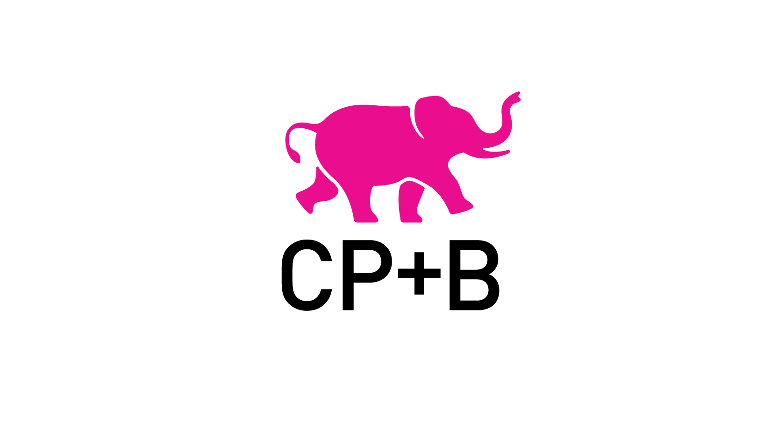

Slide 20
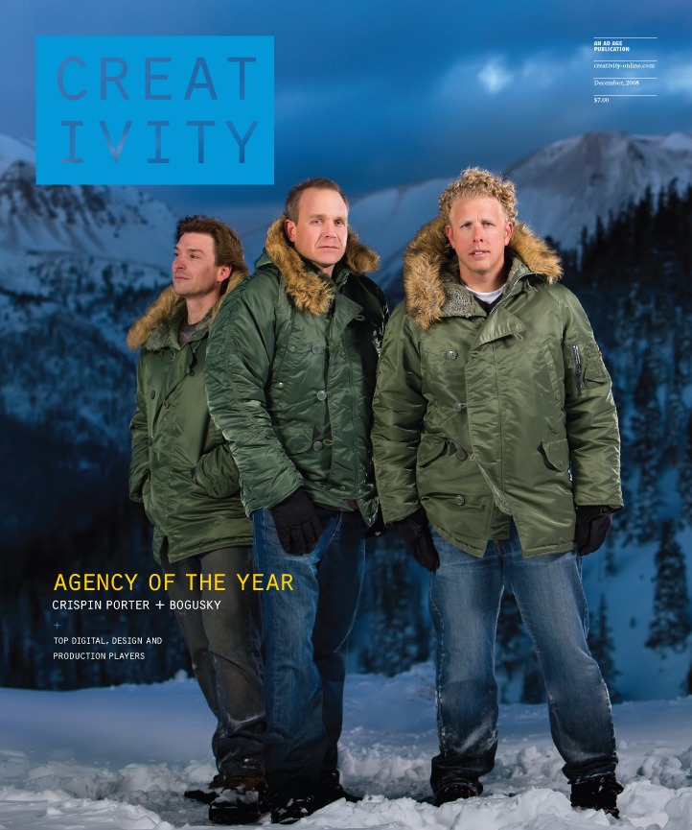

Slide 21
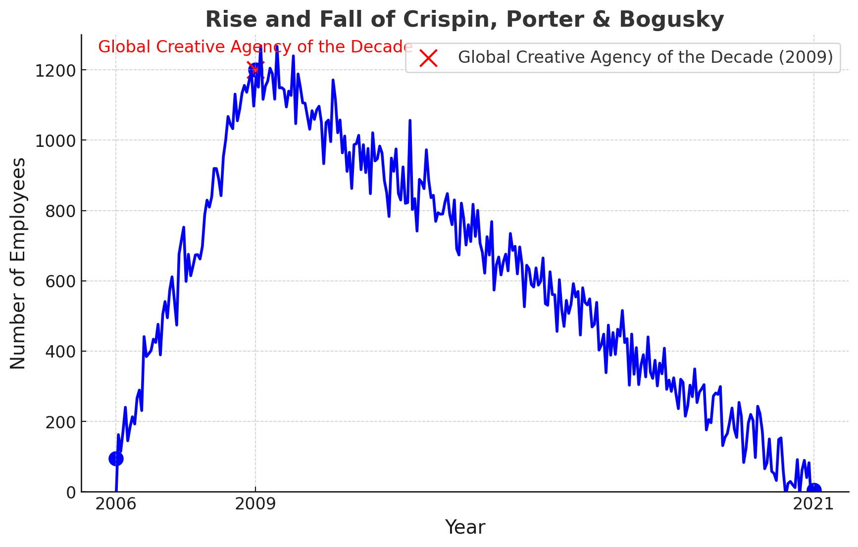

Slide 22
2024

Slide 23
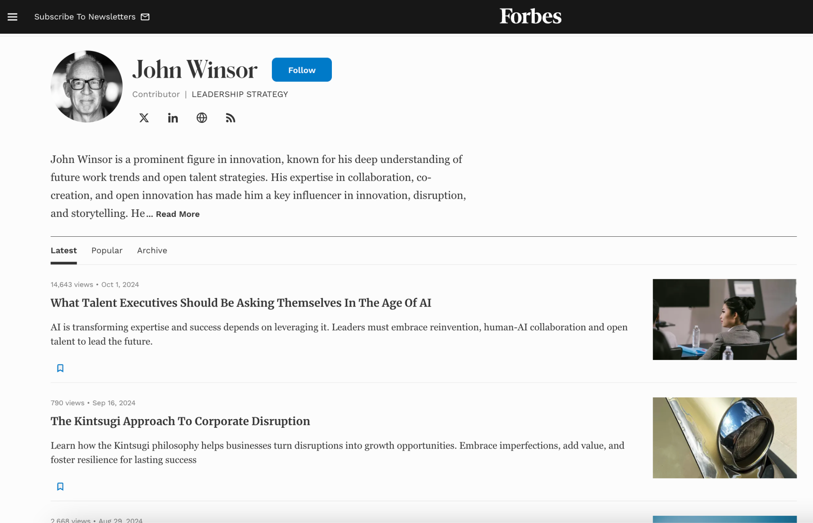

Slide 24
Amazon Q Amazon CEO Andy Jassy announced X (Twitter) August 23, 2024
4500 Saved years of coding
$260m Savings
78% Accurate

Slide 25
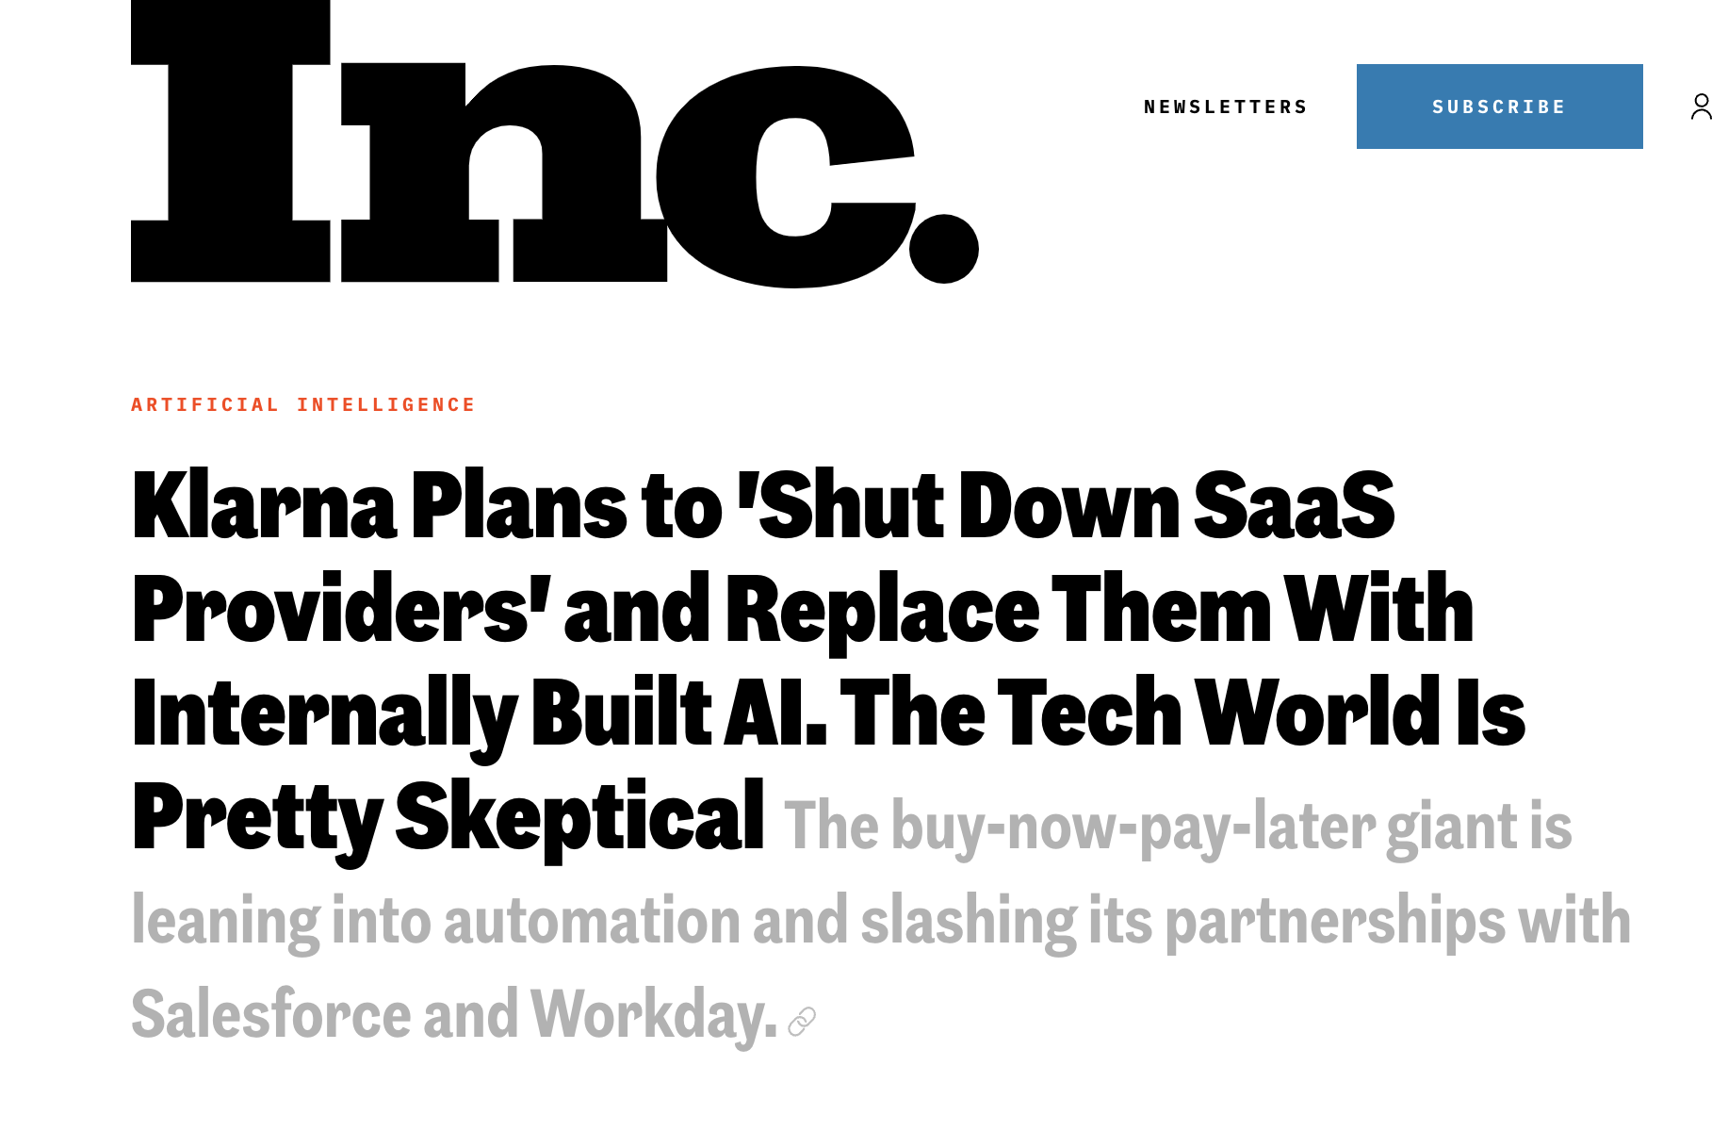

Slide 26
AI could increase global GDP by a staggering $13-15.7T (that’s T for trillion) by 2030.

Slide 27
“McKinsey estimates that 30 percent of the world’s workforce could lose their jobs to AI within a decade, as many as 400 to 800 million people, possibly a worst-case scenario whose negative consequences would be immense”

Slide 28
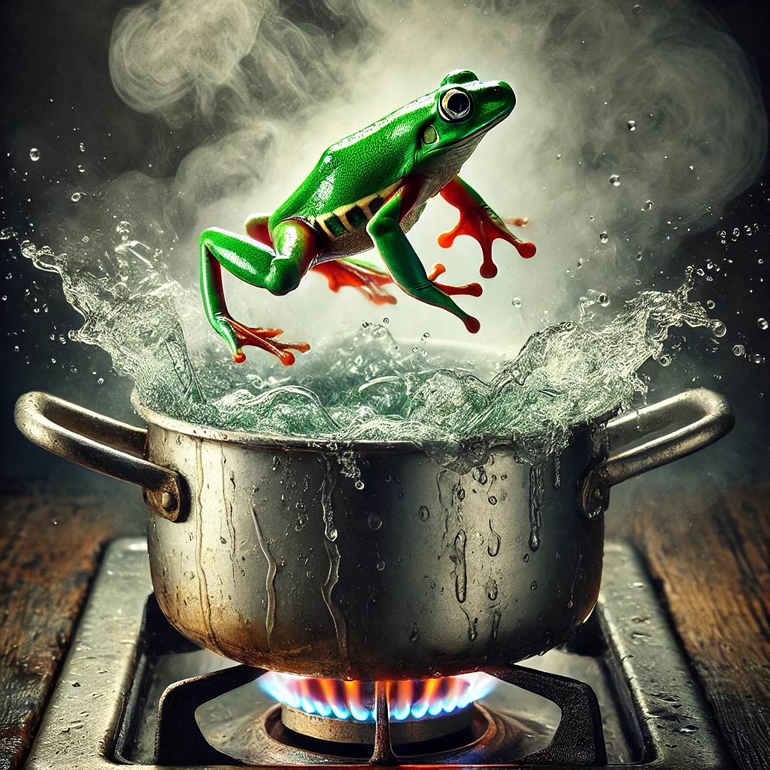

Slide 29
The Talent Revolution Will Be Bottom Up
LISH research on Freelancer.com customers
25 Number of Fortune 500 clients
70% Weekly active emails buying talent

Slide 30
The AI Revolution Will Be Bottom Up BCG research of 1400+ C-Level Executives
25% People using it daily
89% CEOs: AI is top 3 priority
90% CEOs see their company as “observers” of AI

Slide 31
In all of these cases industries had an inside-out view of the world.

Slide 32
5 Stages of Dealing with any Disruption.
Benign neglect
Lordly disdain
Irritation plus obfuscation
Panic
Capitulation

Slide 33
A Way Forward

Slide 35
Create a common language and common process for the future of talent and work.

Slide 36
Open Talent represents the digital transformation of total talent.

Slide 37
Open Talent Economy
vs.
Gig Economy

Slide 38
Open talent is the digital transformation of talent through a globally distributed workforce (both human and synthetic) accessible to companies on-demand via digital connections and platforms.

Slide 39
The Gig Economy consists mainly of business-to-consumer transactions, such as drivers and passengers, and restaurants and take-out food customers.
Gig workers are told where to work and how to deliver the product.

Slide 40
How did all of this happen?

Slide 41
Digital technology has allowed for the rise of a new class of creators and freelancers by radically reducing the cost of production, especially now with GenAI.

Slide 42
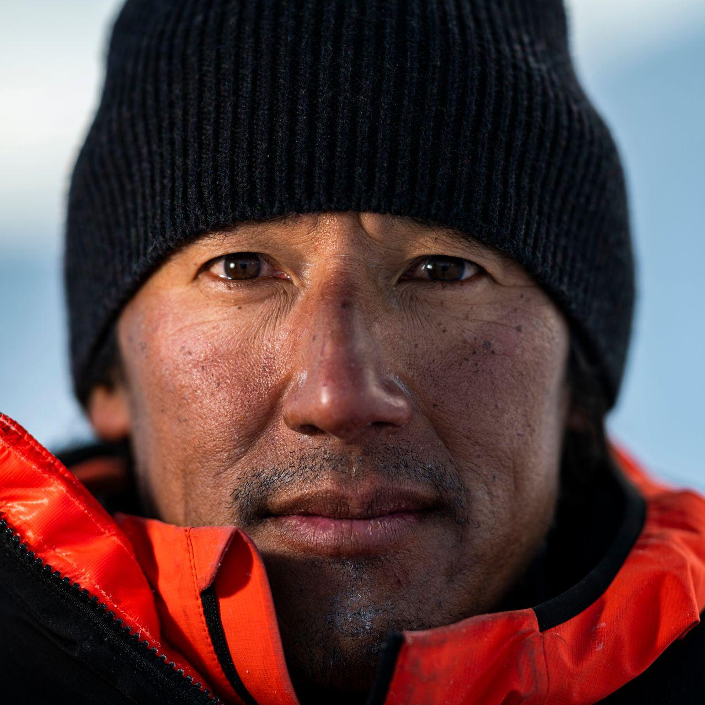

Slide 43
600,000
work in advertising. Consistent from 2012 to 2023.

Slide 44
60,000,000
make money from marketing in social media.

Slide 45
The combination of human talent and synthetic talent will be the future.

Slide 46
No longer will companies hire for jobs and roles.

Slide 47
They will focus on outcomes and define tasks that need to be done.

Slide 48
Matching both human and synthetic skills with the these tasks.

Slide 49
The war for talent is over.

Slide 50
Talent (both human and synthetic) won.

Slide 52
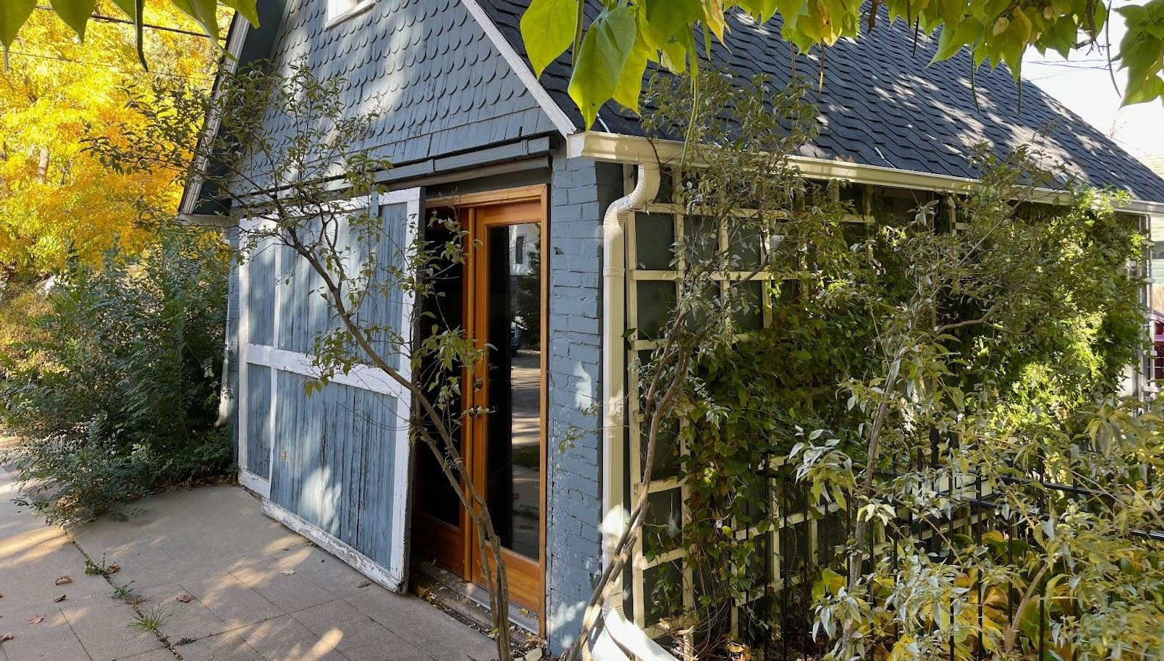

Slide 53
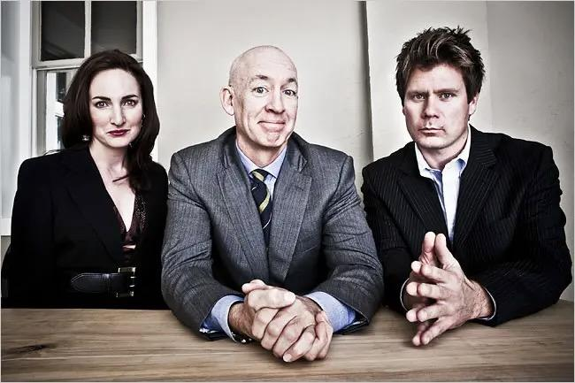

Slide 56
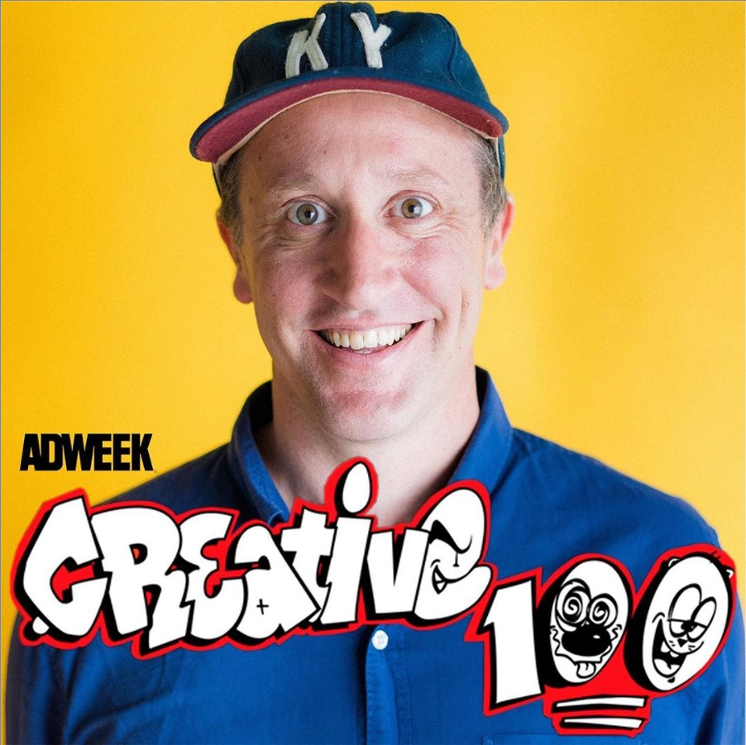

Slide 57
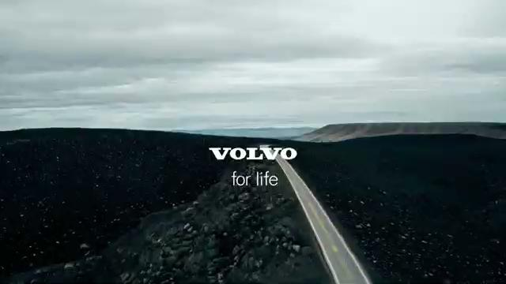

Slide 58
The Transformation
of Work Model

Slide 59
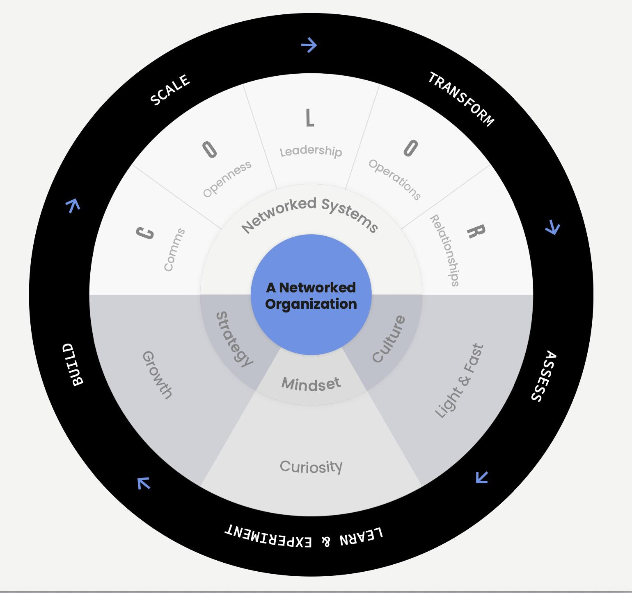
Notes:
What happens if this is where you work.

Slide 60
Transform
1

Slide 61
Transform Your Mindset
Notes:
Slow down.

Slide 62
From Scarcity to Abundance
Notes:
Slow down.

Slide 63
“The vast majority of executives haven’t even tried LLMs. Changing that should be the highest priority of anyone who wants their company to succeed at AI.”
-Ethan Mollick

Slide 64
Transform Your Culture
Notes:
Slow down.

Slide 65
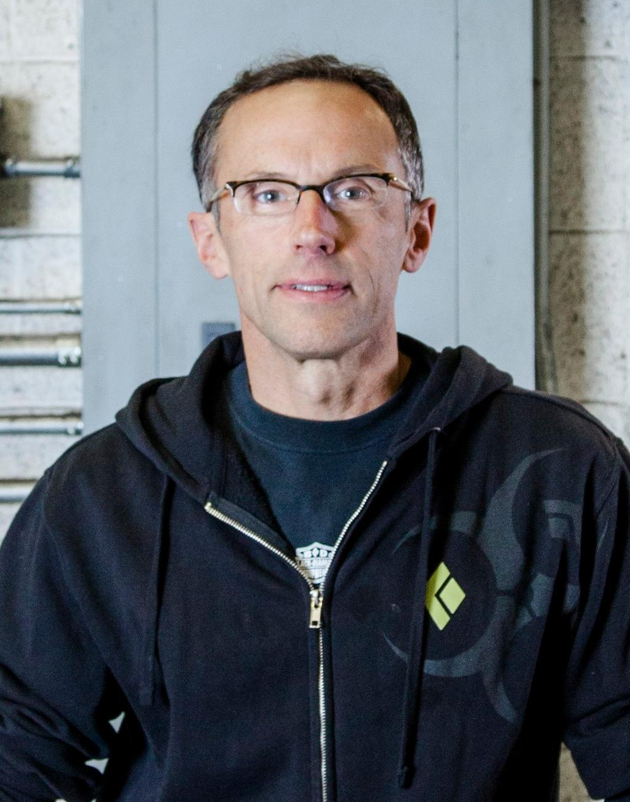

Slide 66
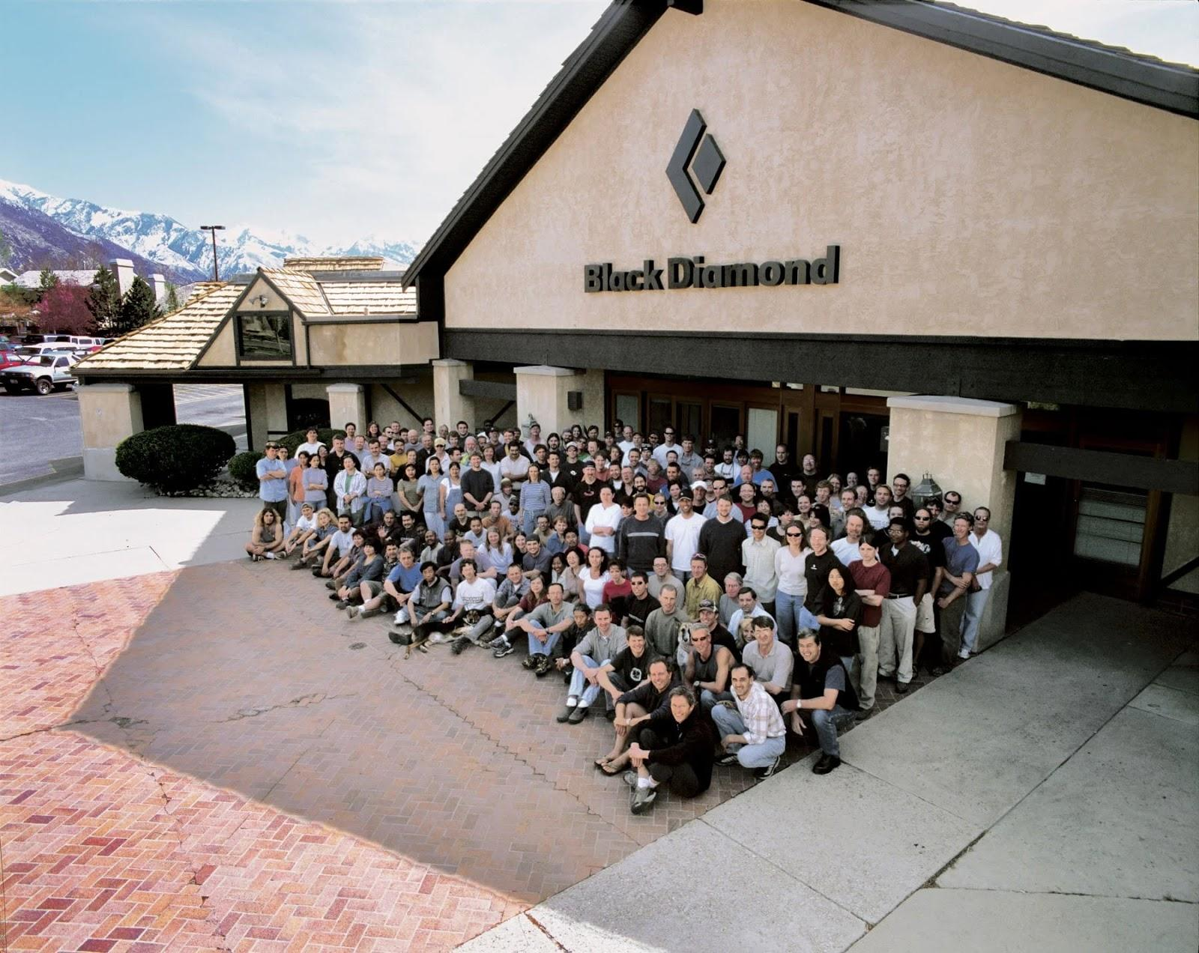

Slide 67
Assess
2

Slide 68
If you want to know where to go, you have to know where you are.

Slide 69
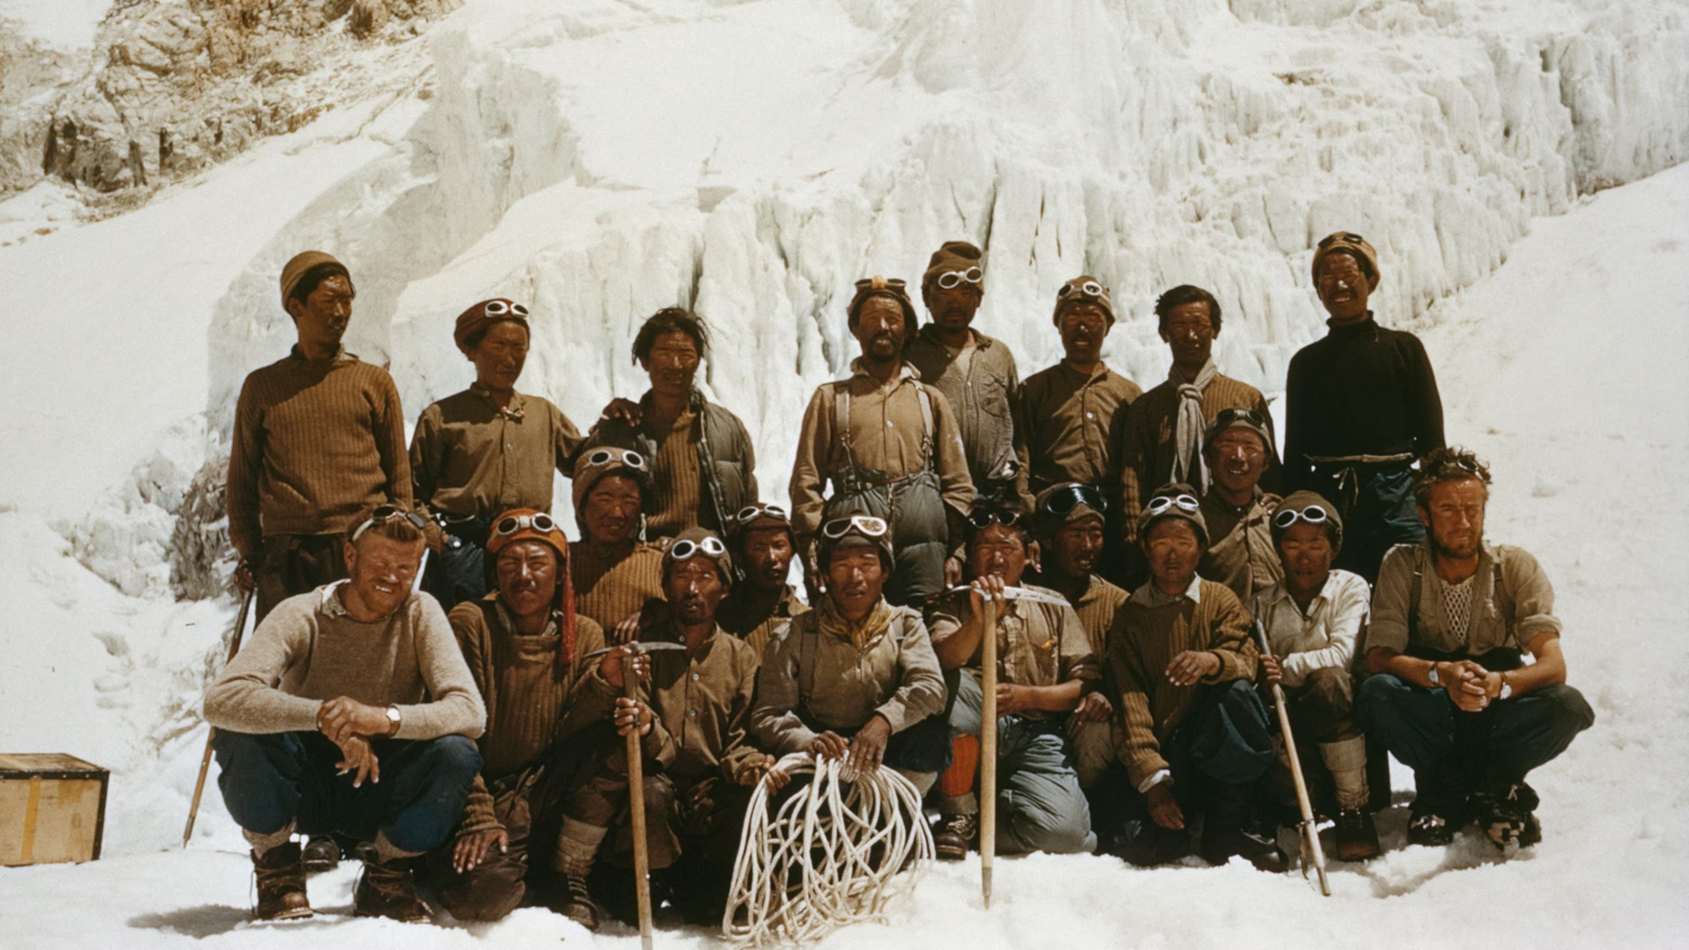

Slide 70
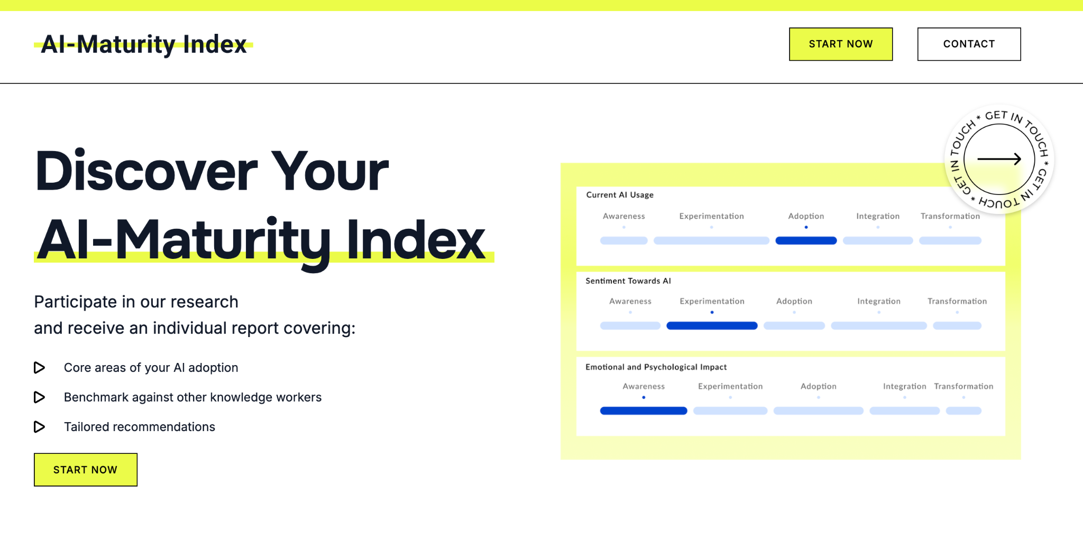
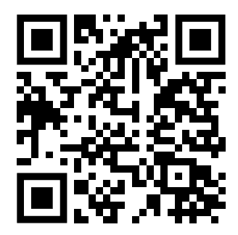

Slide 71
Nearly 2000 participants
47% worry that advancements in AI within the next 5 years will cause them to lose their jobs.
66% of leaders would not hire someone without some AI skills
77% of leaders are more likely to hire a less experienced candidate with AI skills than a more experienced one without them
Results

Slide 72
The learning path is unclear
GenAI landscape is overwhelming. People feel overwhelmed by all the AI tools that keep popping up
Neither companies nor individuals know how to measure their starting point.
ChatGPT is the tip of the iceberg: Tools are changing rapidly and it’s hard to keep up with which to use.
Results

Slide 73
Learn
3

Slide 74
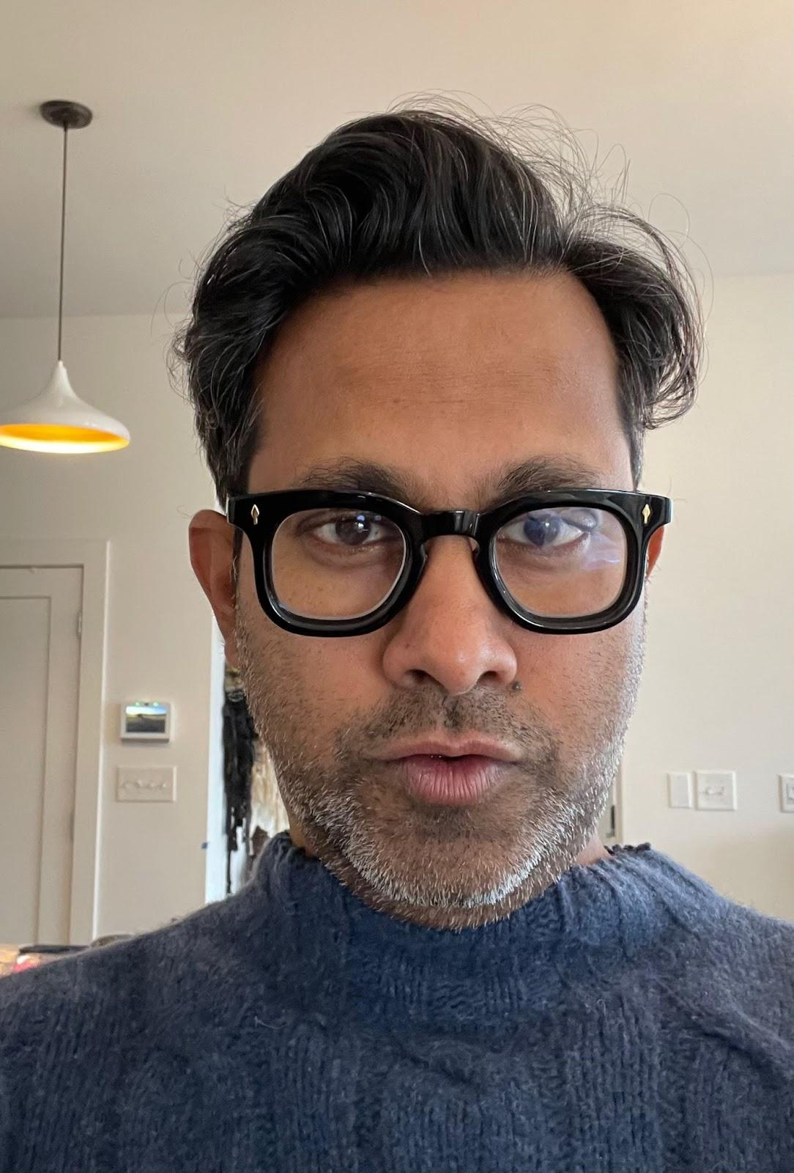

Slide 75
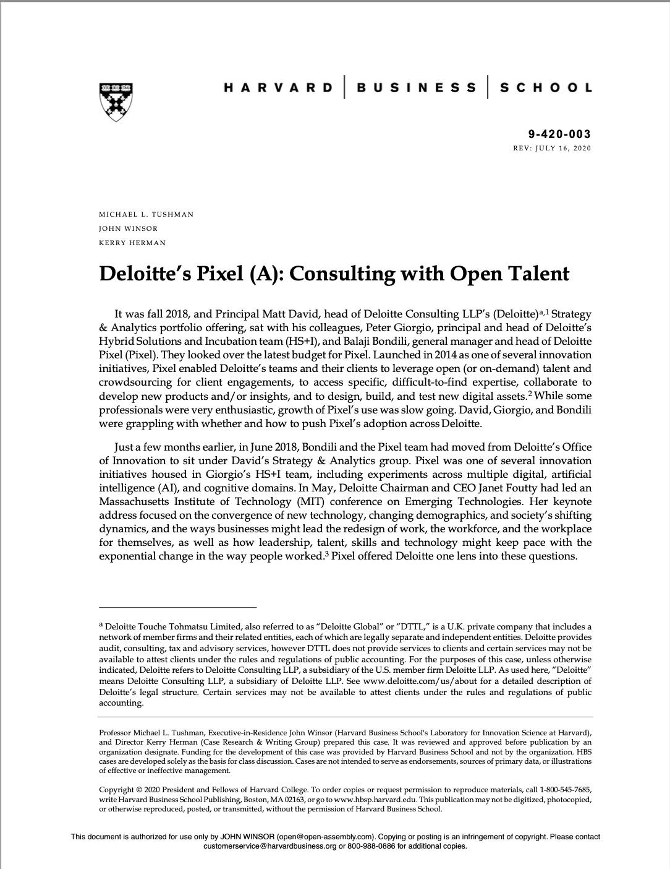
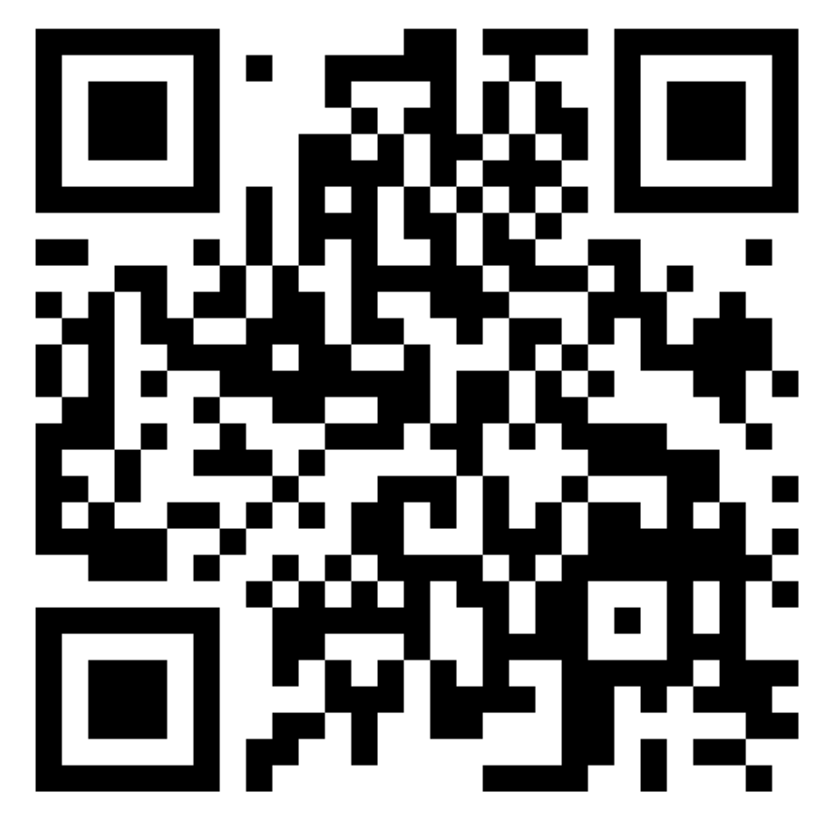

Slide 79
Experiment
4

Slide 82
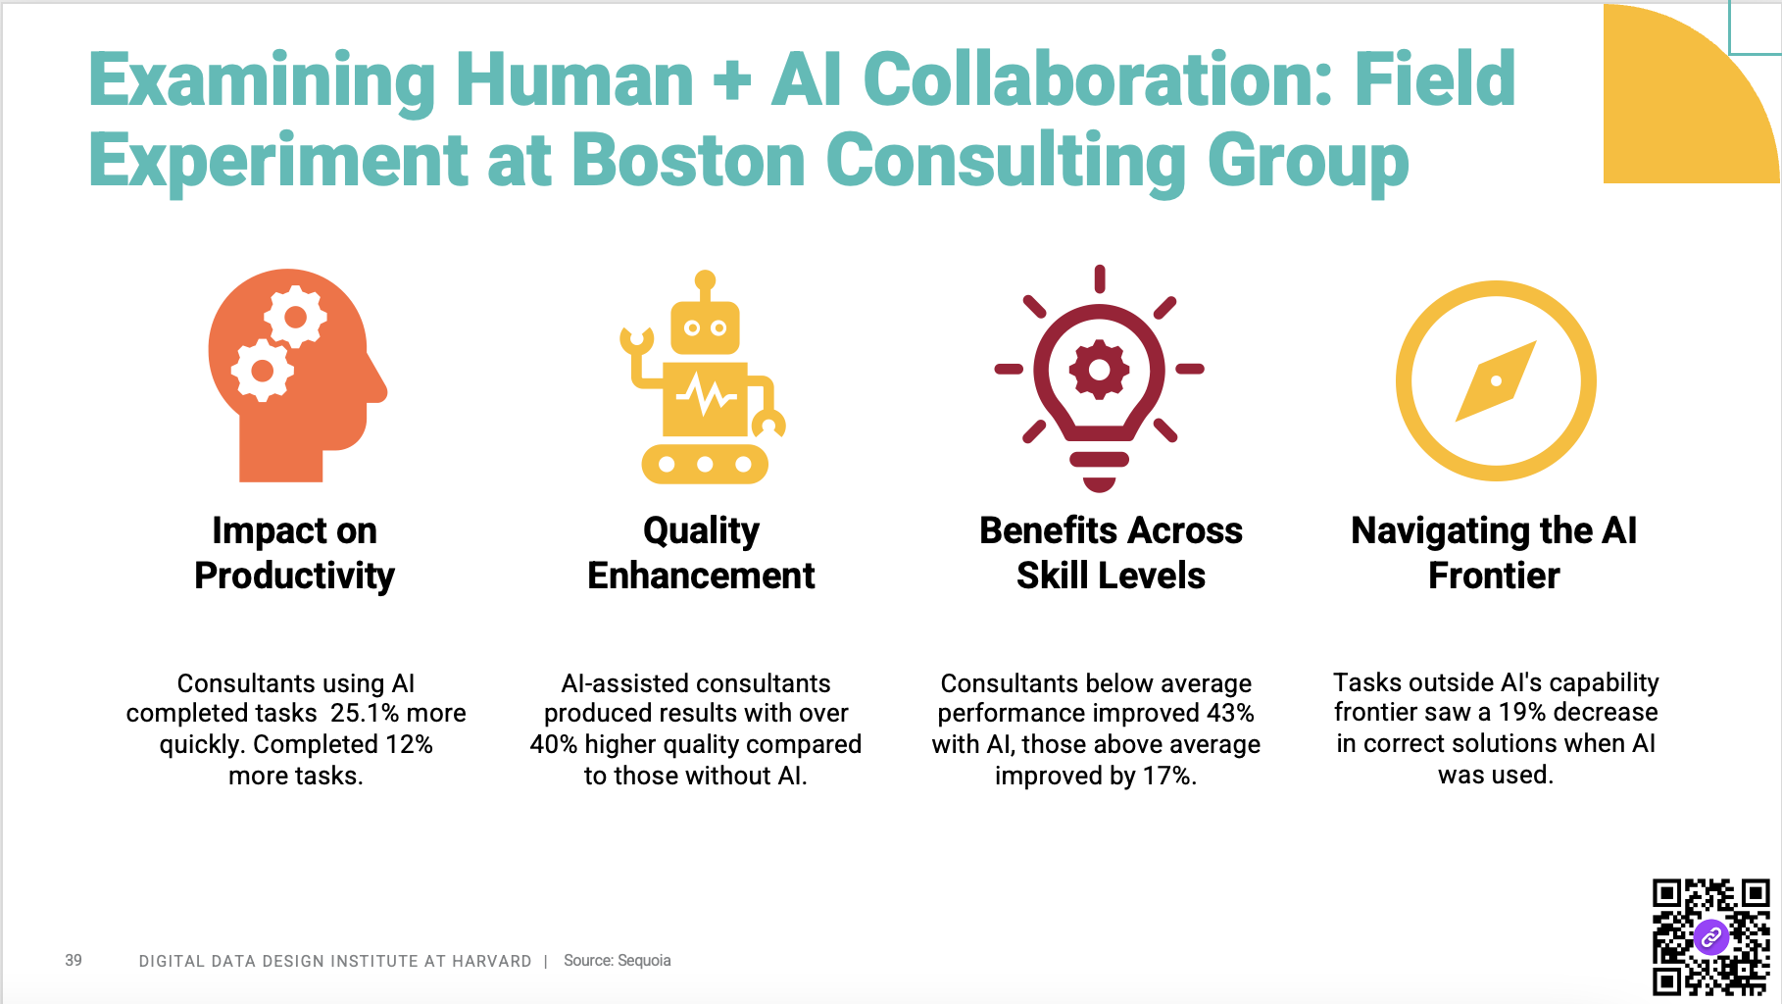

Slide 86
Build
5

Slide 87
Build a Networked Organization
Notes:
I get the sense that we’re

Slide 88
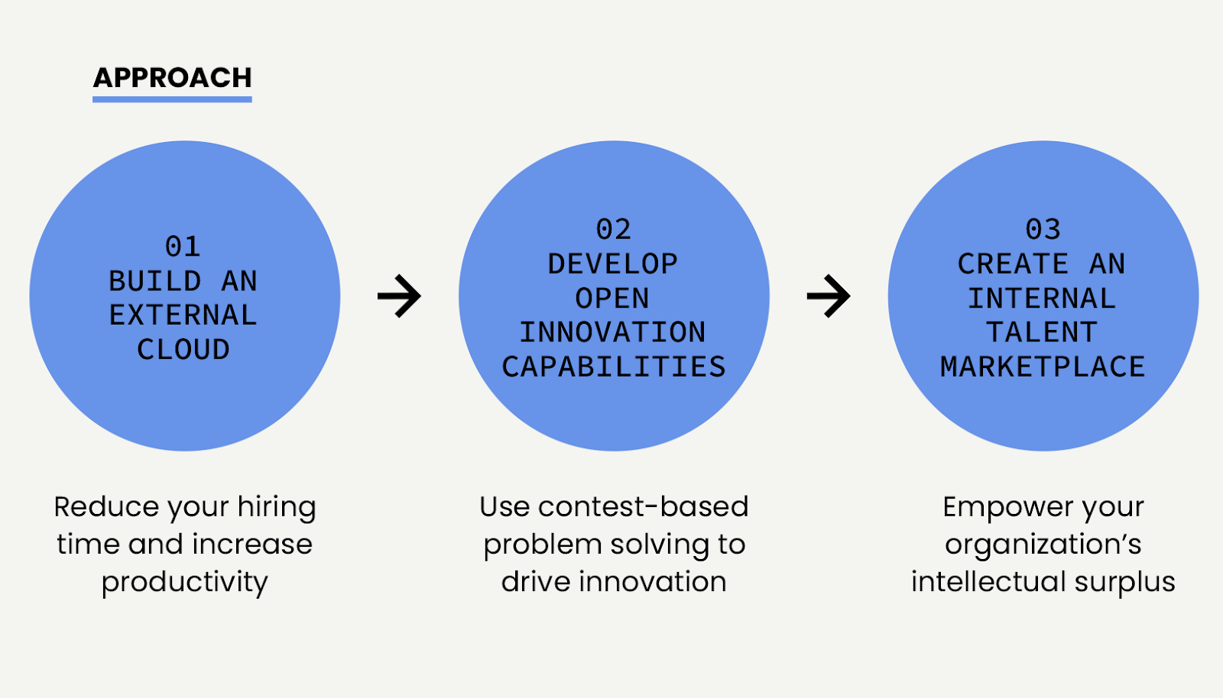

Slide 89
Build an External Talent Cloud

Slide 90
+
Notes:
Slow down.

Slide 91
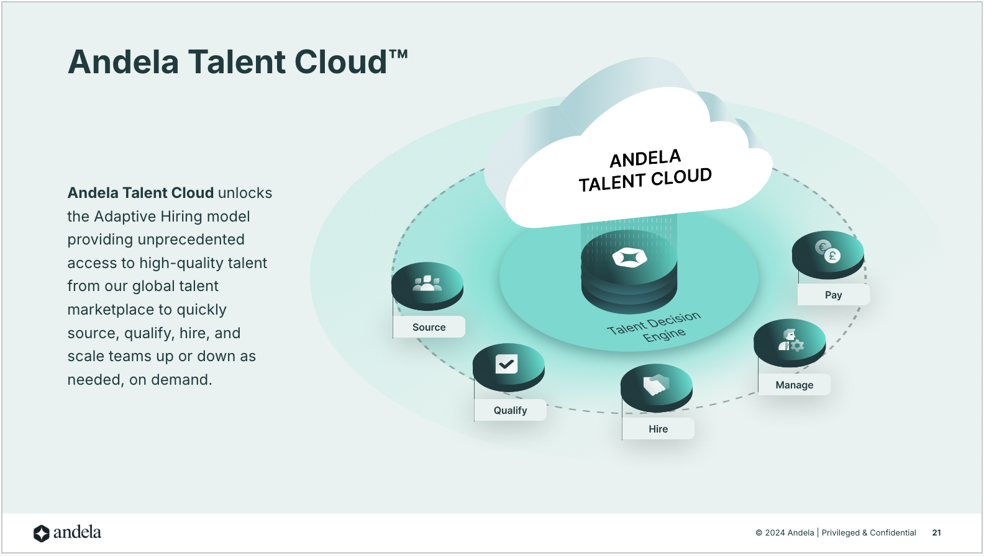

Slide 93
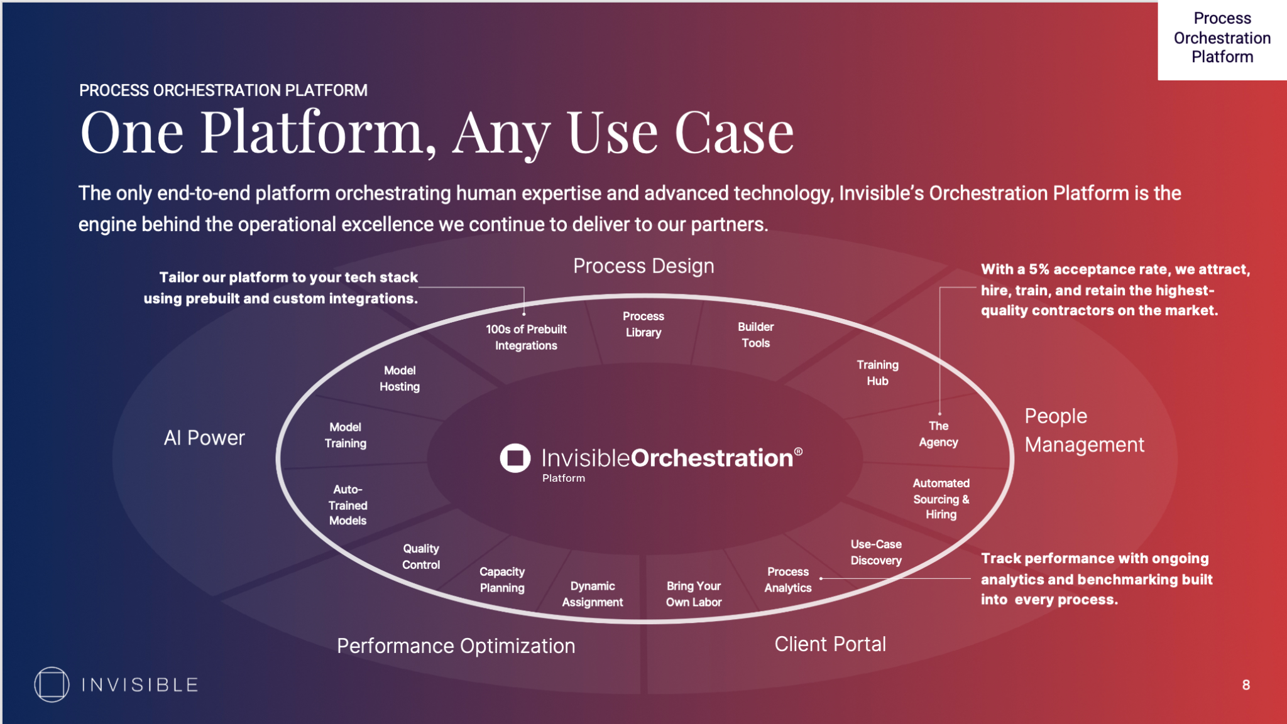

Slide 94
"2025 will be the year of the Al company.
An Al native company is built to embrace Al from the ground up. Many jobs that would typically be staffed by humans will be staffed by machines in Al native companies. Al native companies are most easily built by a startup with minimal embedded overhead or politics.
By contrast, Al adopting companies, those who build Al into established operating businesses, will be hamstrung by legacy processes and employees. It's not that Al won't create value for the established adopters.
It's that the adopters won't be able to fully benefit from it because those companies will make concessions to the way things have always been done, and that will be less efficient than building for Al first."
- Doug Clinton, CEO, Intelligent Alpha

Slide 95
Let’s talk

Slide 96
Thank You johnwinsor@open-assembly.com

